Slide 1
Level Set Methods for Image Segmentation
By Michele Yin

Slide 2
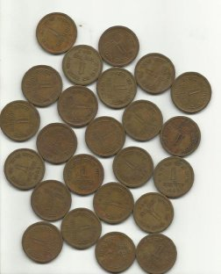
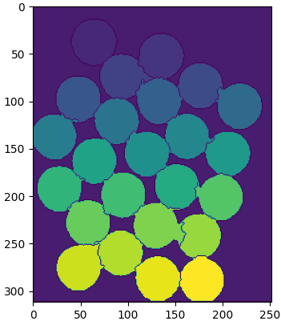
Image segmentation
We try to get semantic segmentation of different areas
Many different techniques

Slide 3
Level-Set Methods ( LSM )
Introduced for the first time in 1988 in “Fronts Propagating with Curvature Dependent Speed: Algorithms Based on Hamilton-Jacobi Formulations” by Stanley Osher and James A. Sethian¹
Tons of different applications nowadays
“Modeling wildland fire propagation with level set methods”²
“Level set method for atomization and evaporation simulations”³
Many others

Slide 4
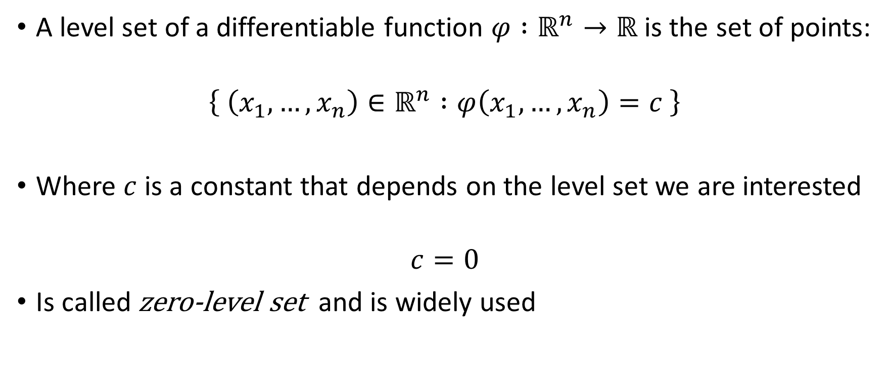
What are level sets
A level set of a differentiable function $φ :ℝ^{n}→ℝ$ is the set of points:
$$\left\{ \left(x_{1},…, x_{n}\right)∈ℝ^{n} :φ\left(x_{1},…,x_{n}\right)=c \right\}$$
Where $c$ is a constant that depends on the level set we are interested
$$c=0$$
Is called zero-level set and is widely used

Slide 5
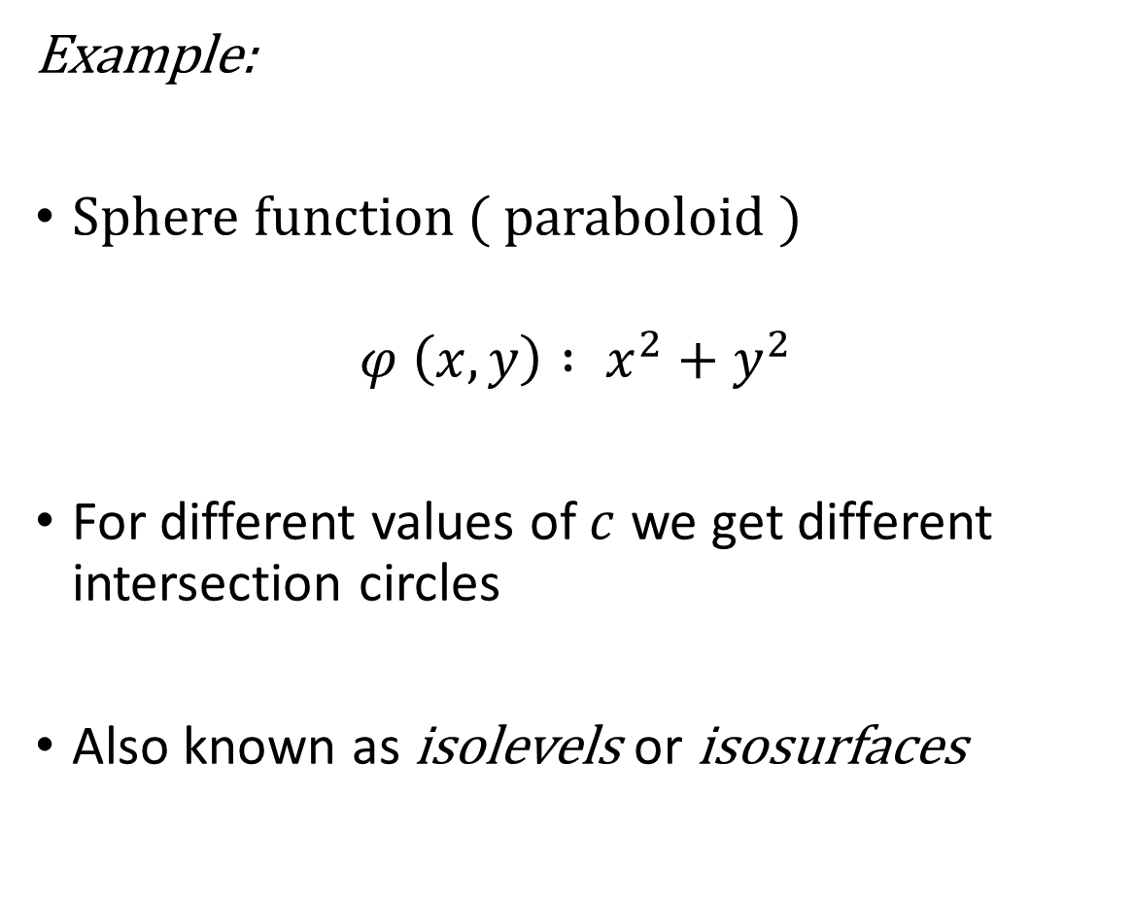
Example:
Sphere function ( paraboloid )
$$φ \left(x,y\right) : x^{2}+y^{2}$$
For different values of $c$ we get different intersection circles
Also known as isolevels or isosurfaces

Slide 6

Level-Set
If $n=2$ the level set is called level curve
Commonly used for computer vision purposes
If $n=3$ the level set is called level surface

Slide 7


Curve $φ$ value
For the zero level set : $\left\{ \left(x_{1},…, x_{n}\right)∈ℝ^{n} :φ\left(x_{1},…,x_{n}\right)=0 \right\}$
$φ\left(x_{1},…,x_{n}\right)<0$ outside the contour
$φ\left(x_{1},…,x_{n}\right)>0$ inside the contour

Slide 8
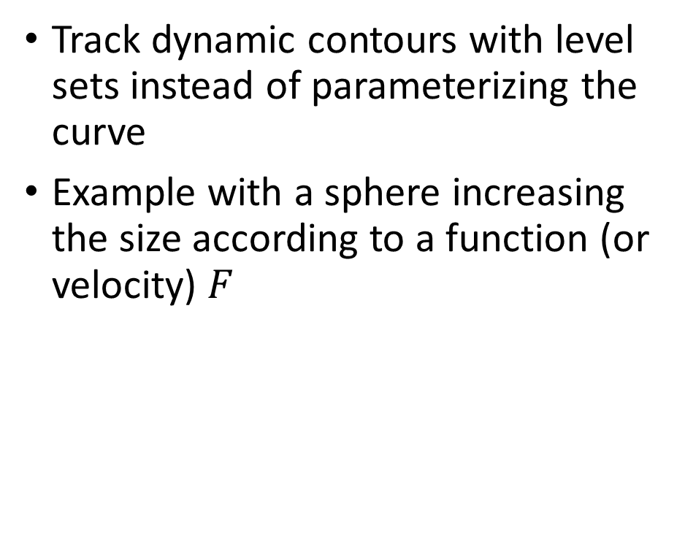
Level-Set Methods ( LSM )
Track dynamic contours with level sets instead of parameterizing the curve
Example with a sphere increasing the size according to a function (or velocity) $F$

Slide 9
Level-Set Methods ( LMS )
What if two spheres merge?
Can we model a natural merging of bubbles ?

Slide 10
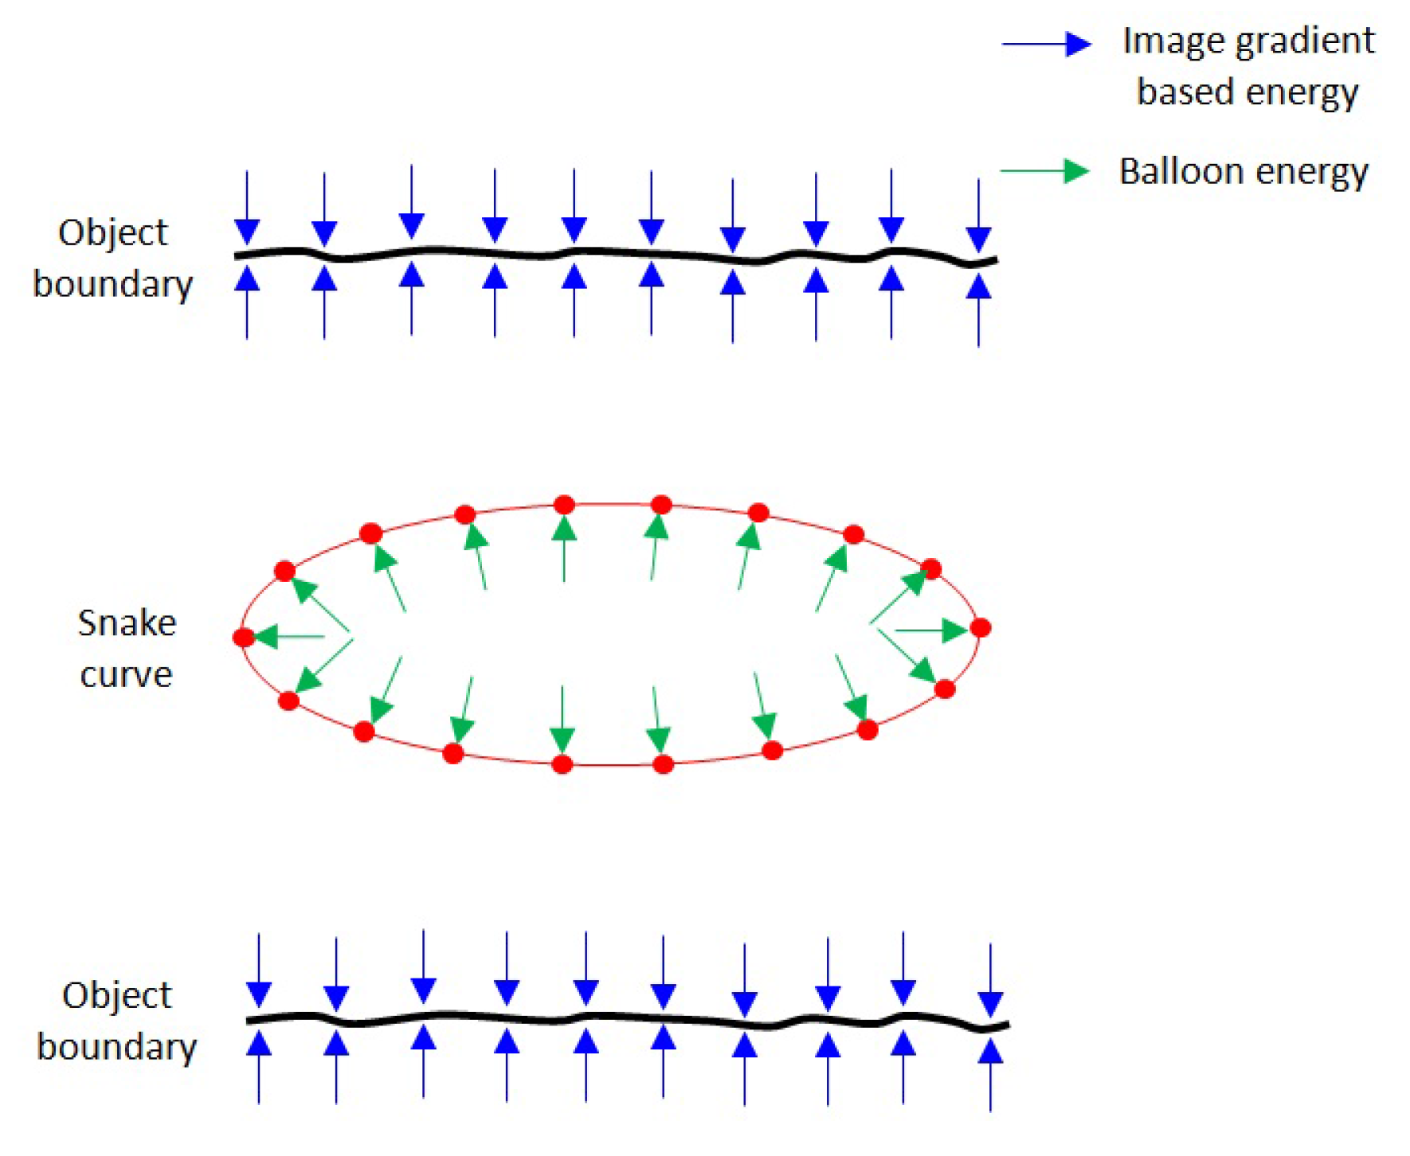
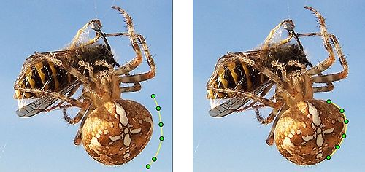
Active contour models ( aka snakes )
Track discrete points on the contour
Hard to parametrize correctly in case of topology changes
Hard to track merging spheres

Slide 11
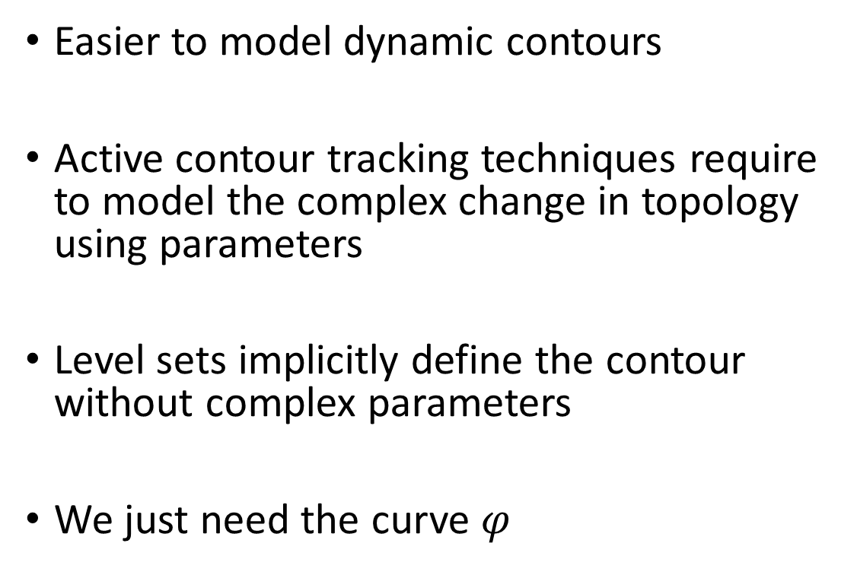
Implicit contours with level sets
Easier to model dynamic contours
Active contour tracking techniques require to model the complex change in topology using parameters
Level sets implicitly define the contour without complex parameters
We just need the curve $φ$

Slide 12
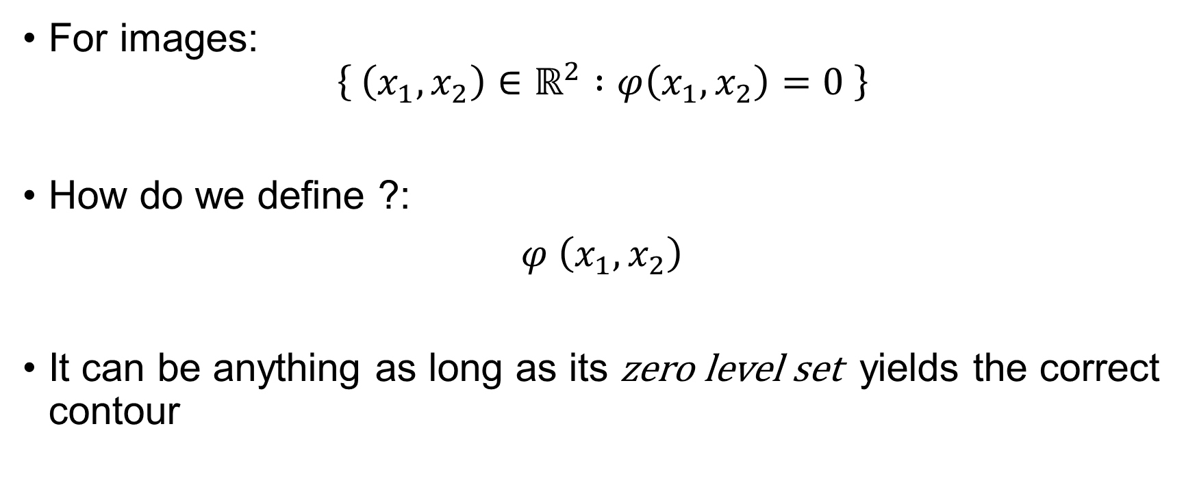
Level-Set Equations
For images:
$$\left\{ \left(x_{1},x_{2}\right)∈ℝ^{2} :φ\left(x_{1},x_{2}\right)=0 \right\}$$
How do we define ?:
$φ \left(x_{1},x_{2}\right)$
It can be anything as long as its zero level set yields the correct contour

Slide 13
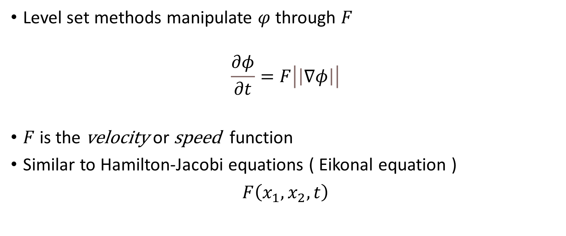
Level-Set Equation Evolution
Level set methods manipulate $φ$ through $F$
$$\frac{∂φ}{∂t}=F\left|\left|∇φ\right|\right|$$
$F$ is the velocity or speed function
Similar to Hamilton-Jacobi equations ( Eikonal equation )
$F\left(x_{1},x_{2},t\right)$

Slide 14
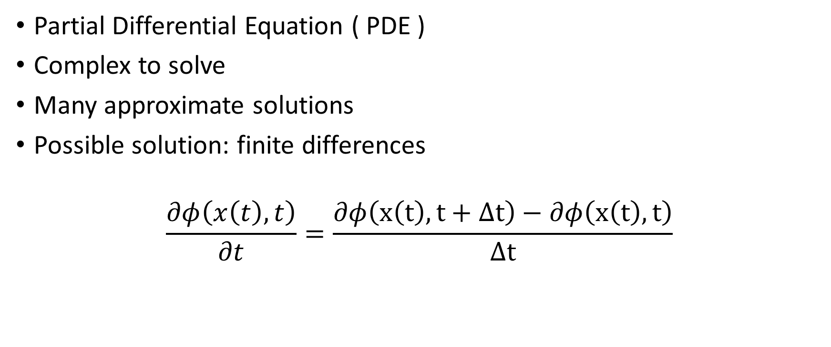
Level-Set Equation Evolution
Partial Differential Equation ( PDE )
Complex to solve
Many approximate solutions
Possible solution: finite differences
$$\frac{∂φ\left(x\left(t\right),t\right)}{∂t}=\frac{∂φ\left(x\left(t\right),t+Δt\right)−∂φ\left(x\left(t\right),t\right)}{Δt}$$

Slide 15
Fast Marching Method
Developed by Sethian in “A Fast Marching Level Set Method for Monotonicaly Advancing Fronts” ⁴ in 1995
Allows to efficiently approximate the solution of the PDE
Similar to Dijkstra

Slide 16
Pros
Topological merging and breaking is handled naturally, and the basic first order scheme is extremely simple to program
Contour computation is made using a discrete cartesian grid
The speed may be an arbitrary function of the curvature ( flame propagation in Oshier )
Simpler than active contour tracking

Slide 17
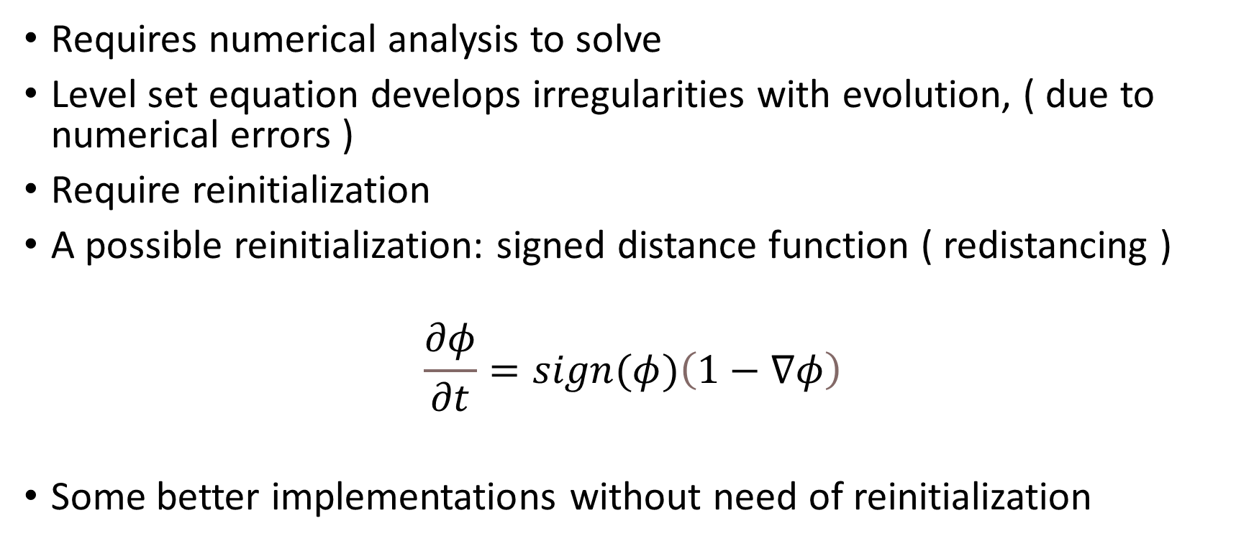
Cons
Requires numerical analysis to solve
Level set equation develops irregularities with evolution, ( due to numerical errors )
Require reinitialization
A possible reinitialization: signed distance function ( redistancing )
$$\frac{∂φ}{∂t}=sign(φ)\left(1−∇φ\right)$$
Some better implementations without need of reinitialization

Slide 18
Examples
Without redistancing
With redistancing

Slide 19
Epilepsy warning

Slide 20

What about image segmentation
Choose a $F$ that is close to 0 at the contours of the image $I$
$$F=\frac{1}{1+||∇I||}$$

Slide 22
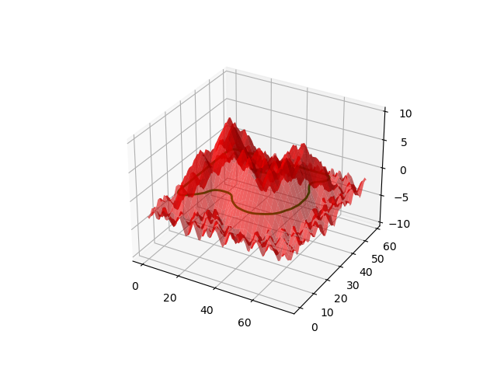
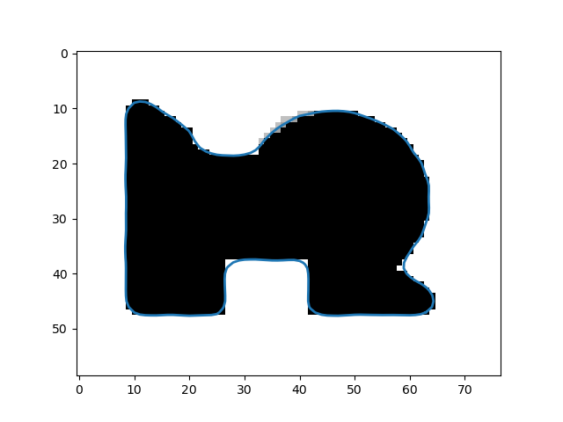
Some state of the art implementations
Distance Regularized Level Set Evolution and Its Application to Image Segmentation - Chunming Li, Chenyang X, Changfeng Gui, and Martin D. Fox, (2010)
https://github.com/Ramesh-X/Level-Set
No need for reinitialization

Slide 23
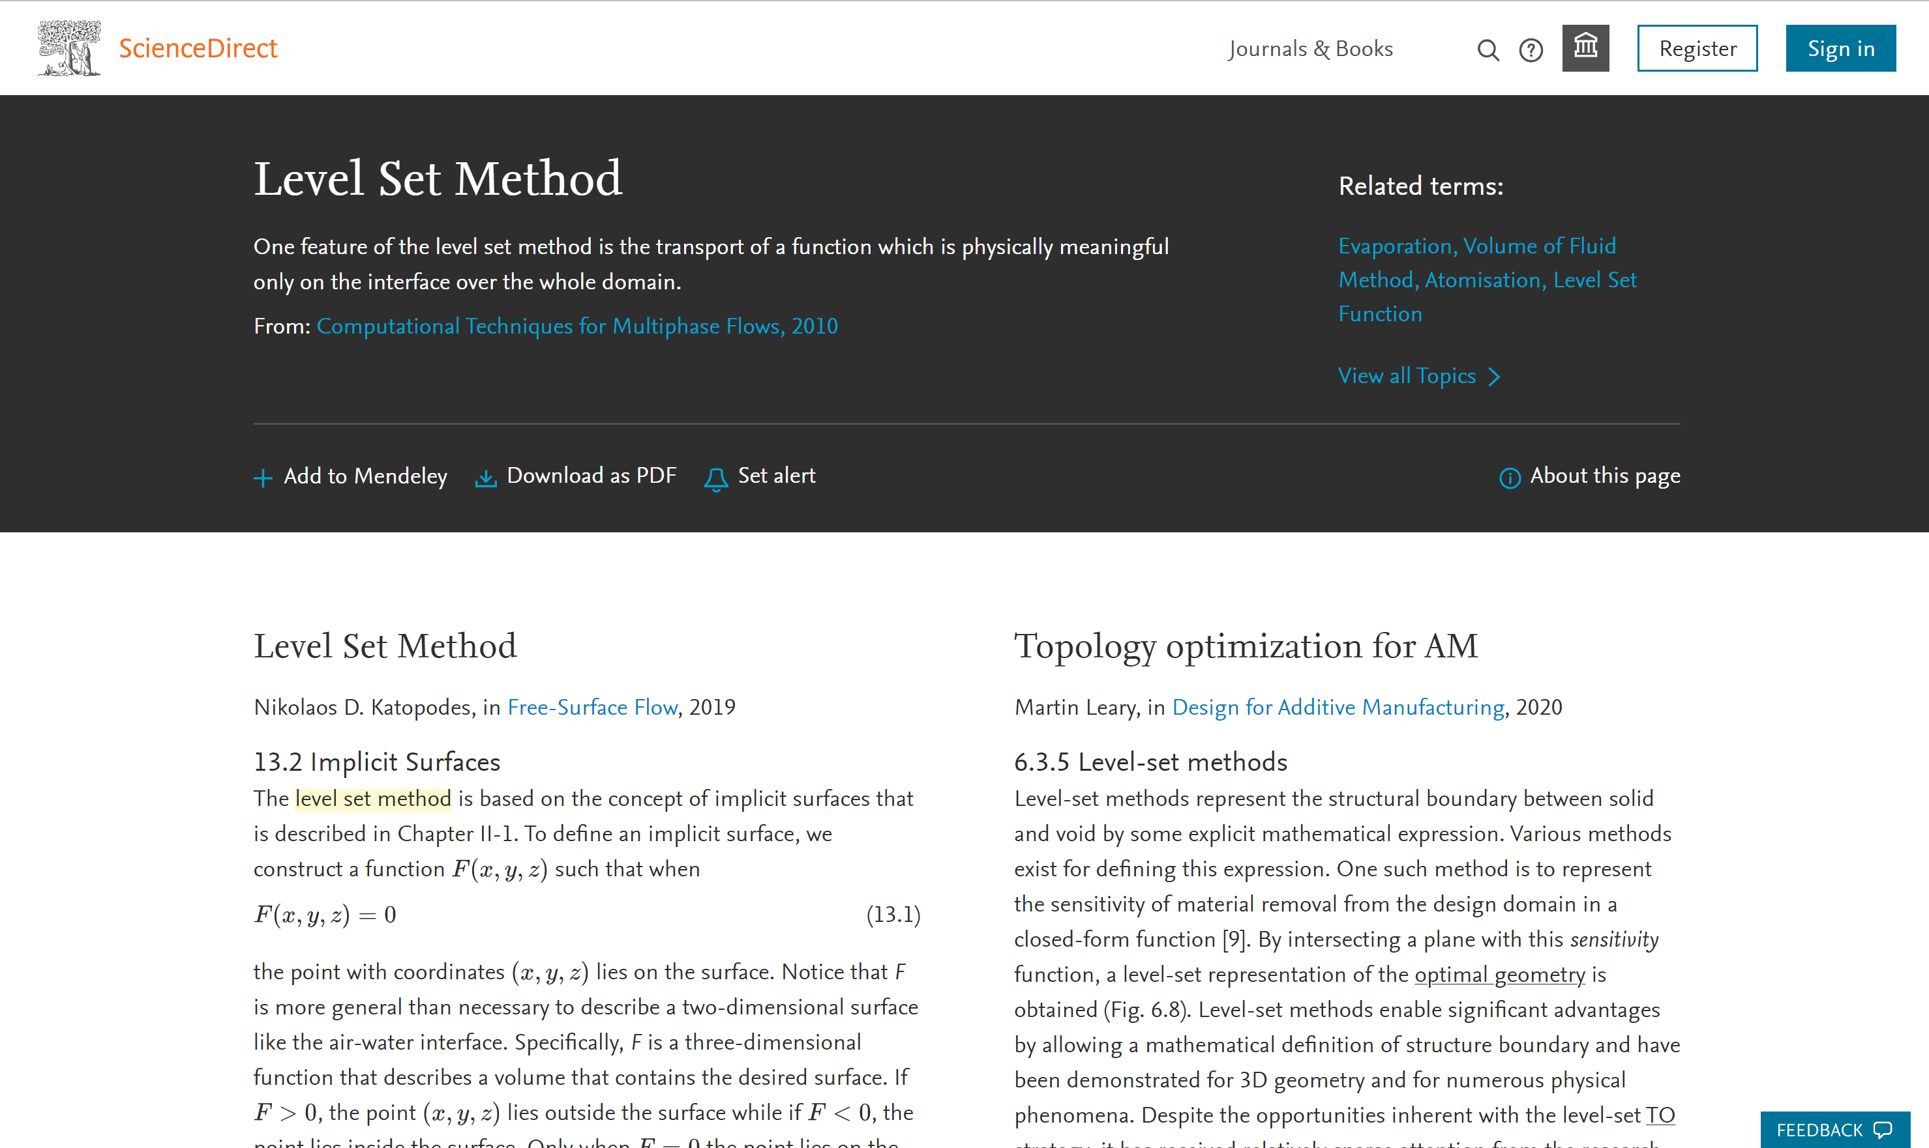
Lots of applications

Slide 24
Marching Squares Algorithm

Slide 25
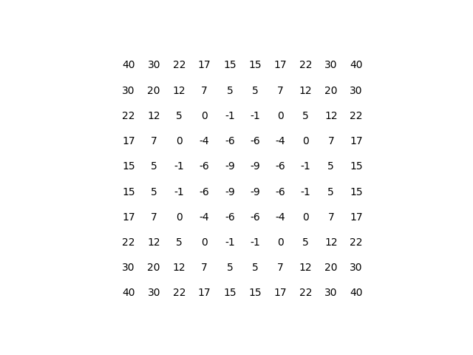
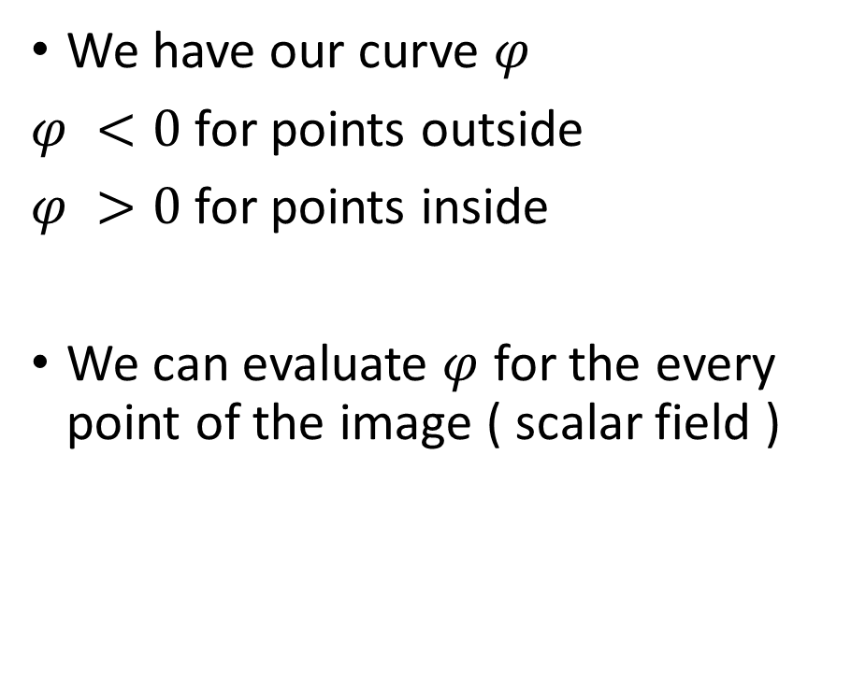
From implicit curve to contours
We have our curve $φ$
$φ <0$ for points outside
$φ >0$ for points inside
We can evaluate $φ$ for the every point of the image ( scalar field )

Slide 26
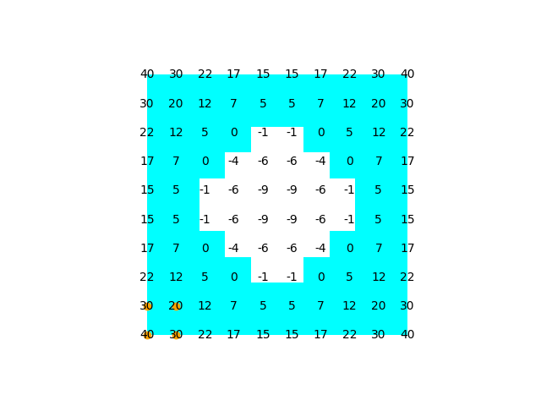
From implicit curve to contours
Threshold the scalar field to get a binary mask
Evaluate a square of points at the time

Slide 27
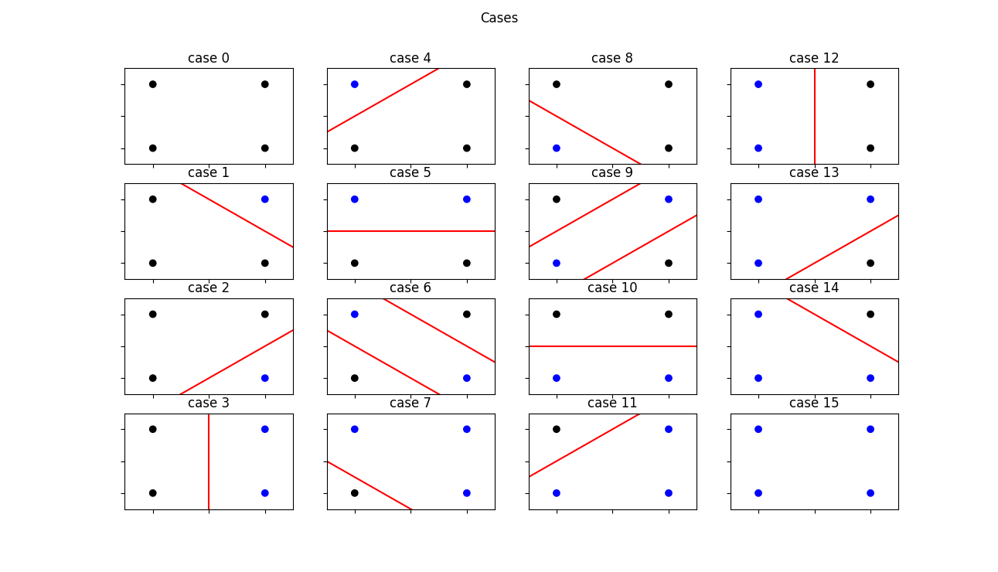
Cases

Slide 28
From implicit function to contour
Fast
Embarrassingly Parallel
Simple
Extensions for 3D and more precise implementations

Slide 30
Bibliography
https://en.wikipedia.org/wiki/Marching_square
https://en.wikipedia.org/wiki/Fast_marching_method
https://en.wikipedia.org/wiki/Active_contour_model
https://en.wikipedia.org/wiki/Eikonal_equation
https://en.wikipedia.org/wiki/Level-set_method
https://math.berkeley.edu/~sethian/2006/Explanations/level_set_explain.html
https://math.berkeley.edu/~sethian/2006/Papers/sethian.fastmarching.pdf
https://math.berkeley.edu/~sethian/Papers/sethian.osher.88.pdf

Slide 31
Bibliography
https://math.mit.edu/classes/18.086/2007/levelsetpres.pdf
https://math.mit.edu/classes/18.086/2006/am57.pdf
https://profs.etsmtl.ca/hlombaert/levelset/
https://www.researchgate.net/publication/290437036_A_level_set_method_using_the_signed_distance_function
https://www.sciencedirect.com/science/article/pii/S0021999117307441#br0070
https://agustinus.kristia.de/techblog/2016/11/05/levelset-method/
https://citeseerx.ist.psu.edu/viewdoc/download?doi=10.1.1.1083.7076&rep=rep1&type=pdf
https://ieeexplore.ieee.org/stamp/stamp.jsp?arnumber=5557813

Slide 32
Repo git with my code:
https://github.com/BigEmperor26/Level-Set-Methods-for-Signal-Image-and-Video

Slide 33
Thanks for your attention

